Slide 1
React server side rendering
Koa, webpack, routing, redux
Notes:
Фіваффіавф іва

Slide 2
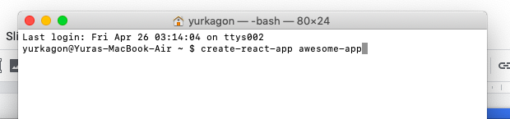
create-react-app

Slide 3
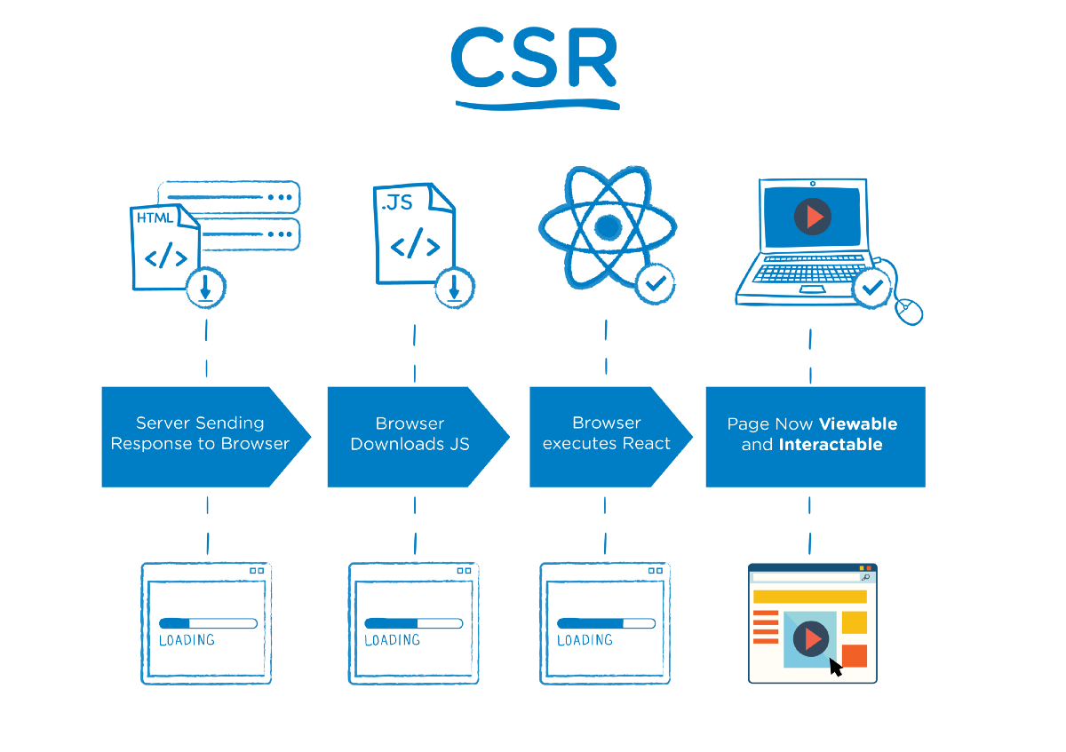

Slide 5
Benefits CSR
Decreased load on the server
Good UI/UX interactivity
Static hosting

Slide 6
Disadvantages CSR
Slow initial render
Non-SEO friendly

Slide 7
SSR + SPA = Universal App

Slide 8
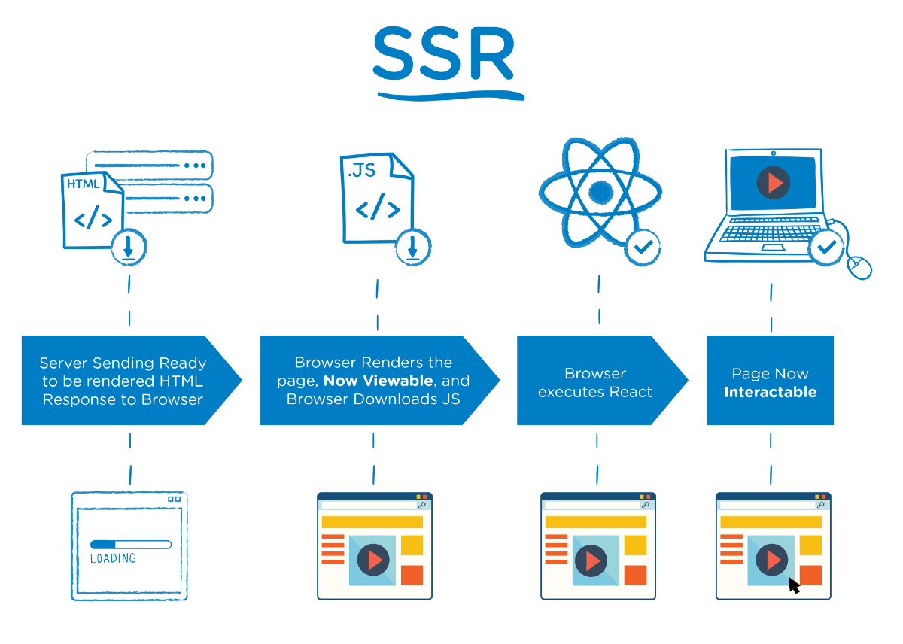

Slide 9
Benefits SSR
Fast first paint
Better perceived perfomance
SEO friendly

Slide 10
Disadvantages SSR
Increased load on the server
Latency due to page request / reloads
Non interactive page until React excutes

Slide 11
React/Redux SSR app via Koa.js

Slide 12
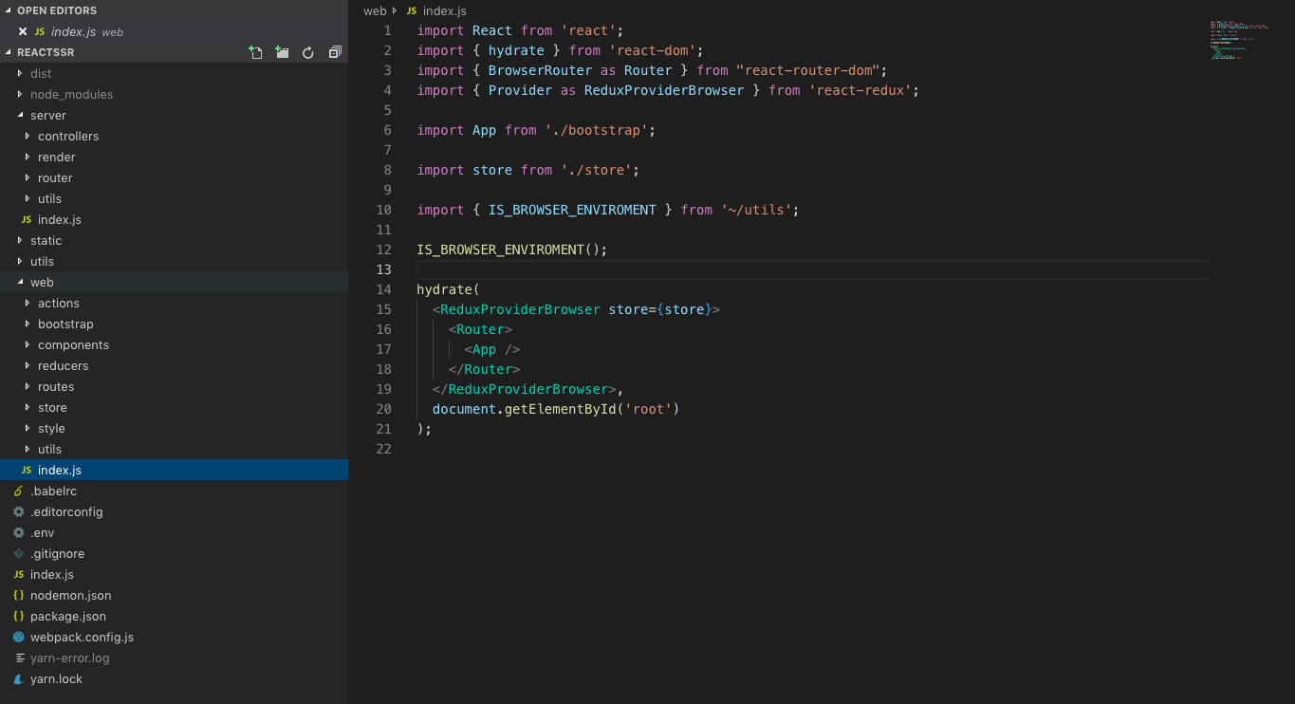
Project skeleton

Slide 13
Basic setup

Slide 14
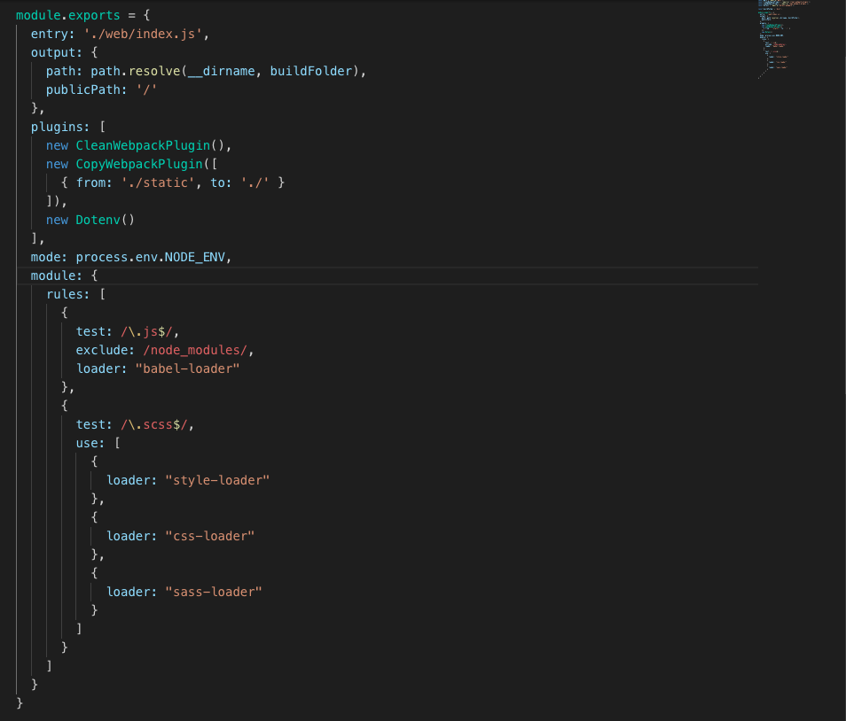
Wepback
~/webpack.config.js

Slide 15
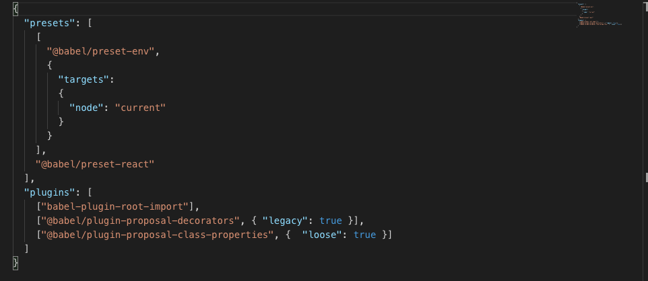
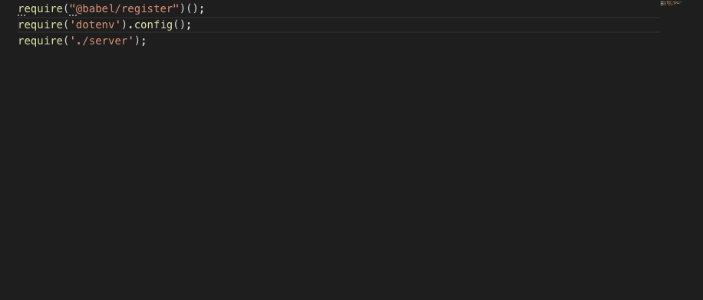
Babel
~/.babelrc
~/index.js

Slide 16
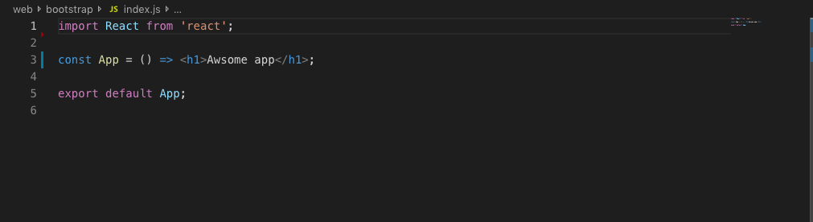
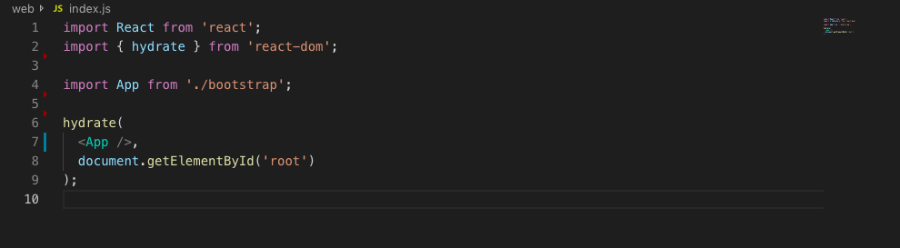
Client
~/web/bootstrap/index.js
~/web/index.js

Slide 17
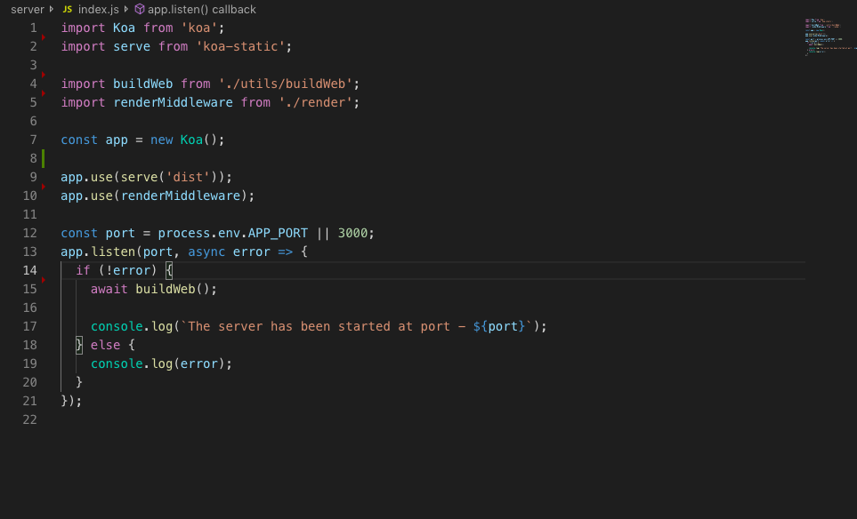
Server (bootstrap)
~/server/index.js

Slide 18
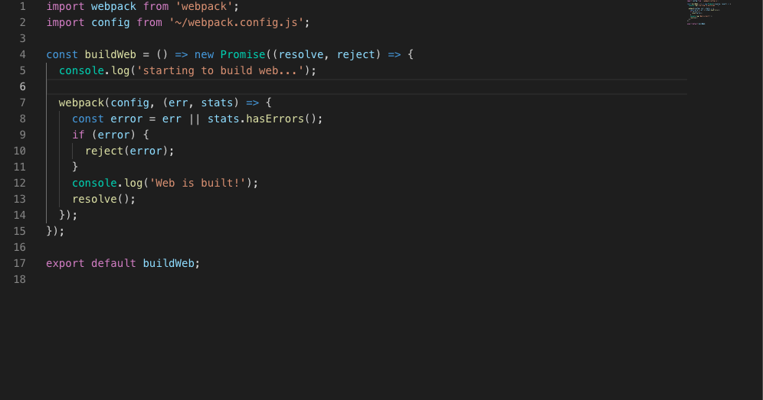
buildWeb.js
~/server/utils/buildWeb.js

Slide 19
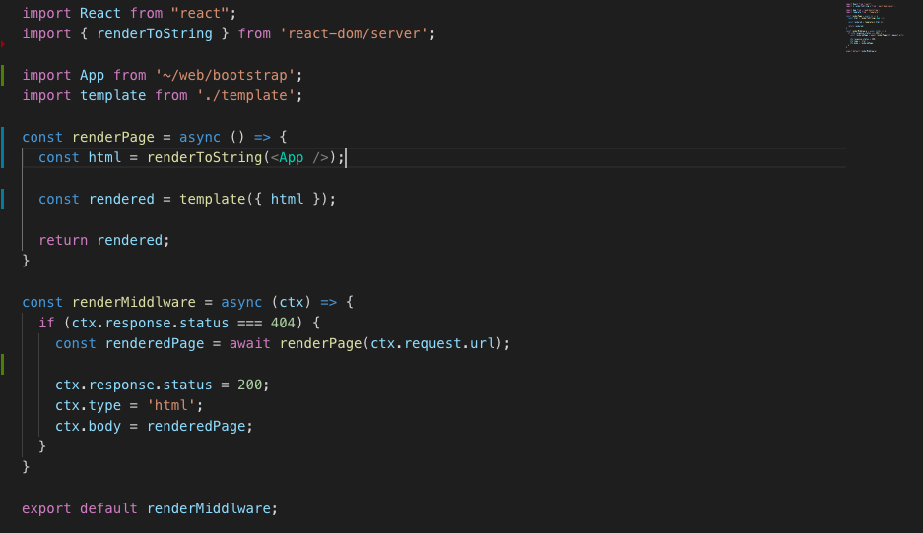
Rendering on server
~/server/render/render.js

Slide 20
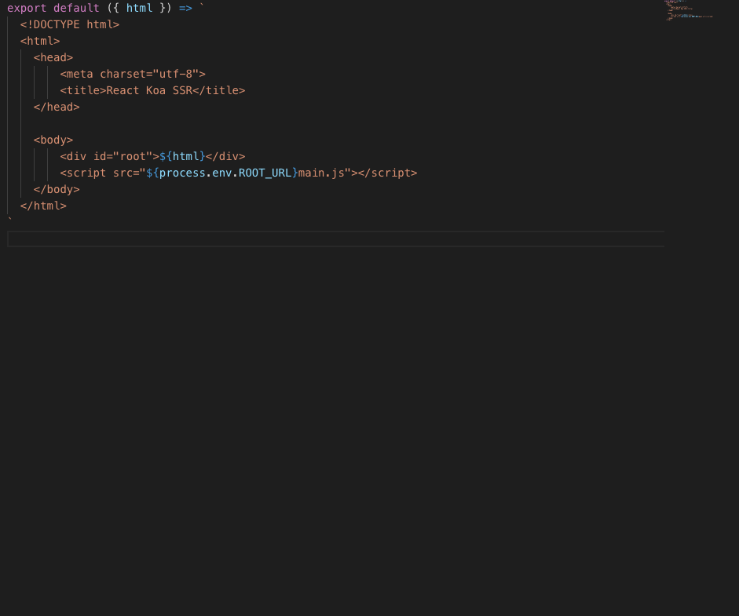
HTML template
~/server/render/template.js

Slide 21
Styles (SASS)

Slide 22
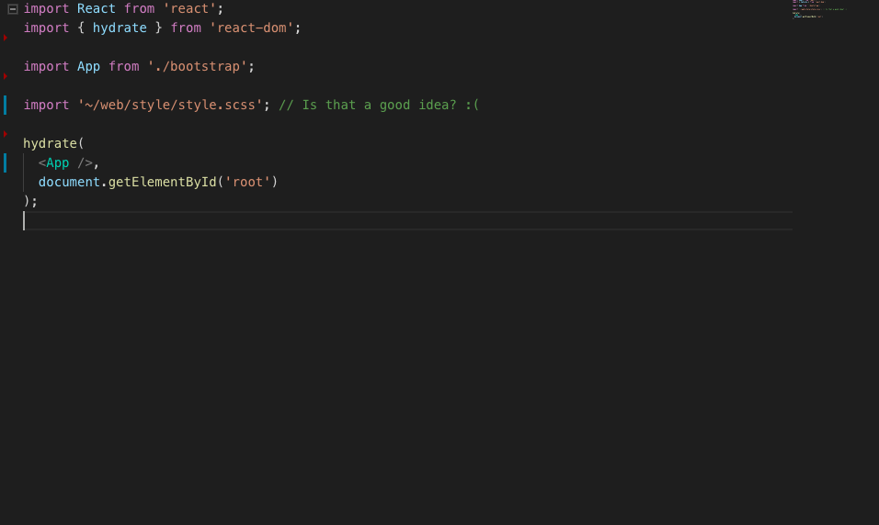
Importing via webpack
~/web/index.js

Slide 23
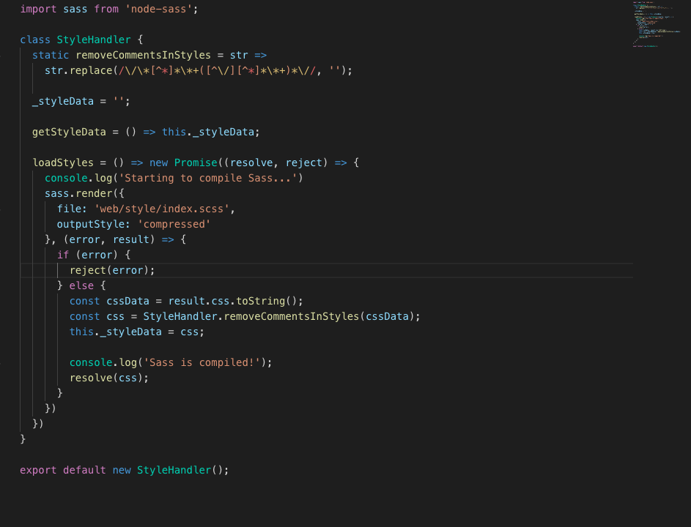
StyleHandler
~/server/utils/StyleHandler.js

Slide 24
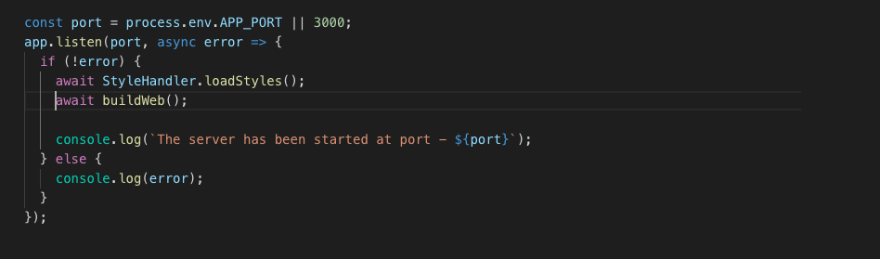
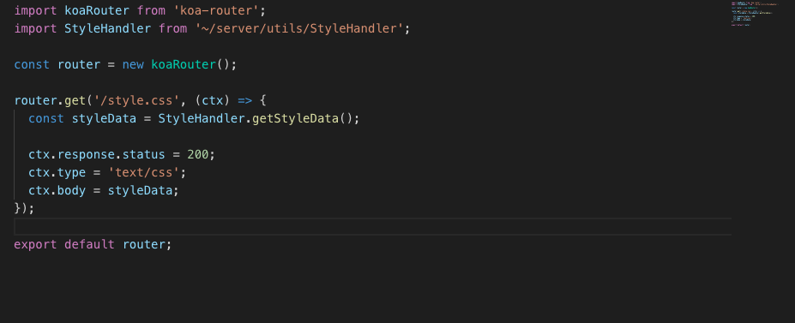
StyleHandler (usage)
~/server/index.js
~/server/router/index.js

Slide 25
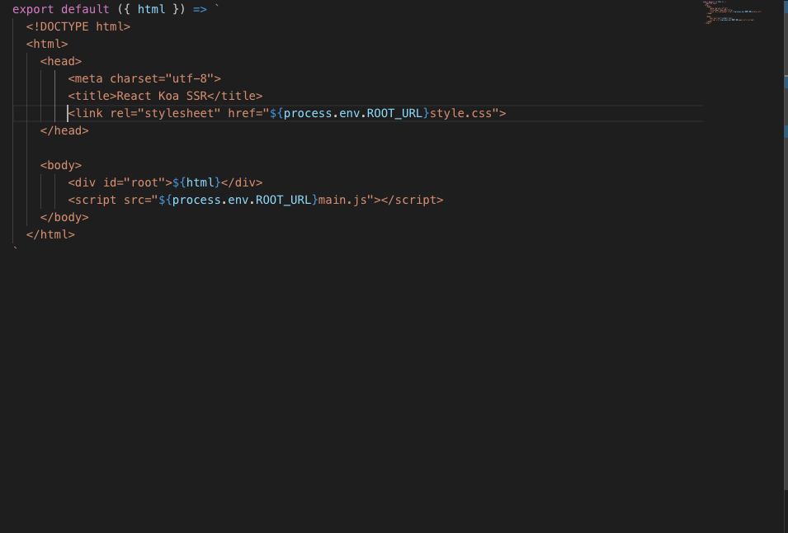
Update template
~/server/render/template.js

Slide 26
Other solutions
Styled components (need to update babel config)
Isomorphic-style-loader (need to build server from webpack)

Slide 27
React Router

Slide 28
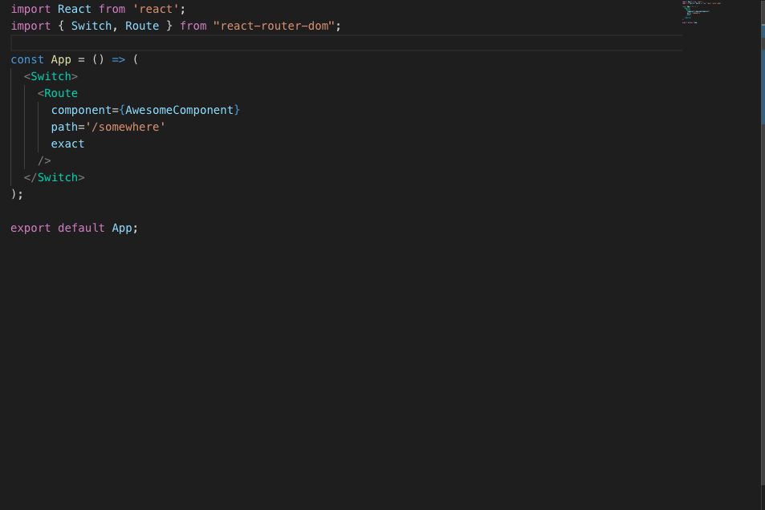
Make some routes
~/web/bootstrap/index.js

Slide 29
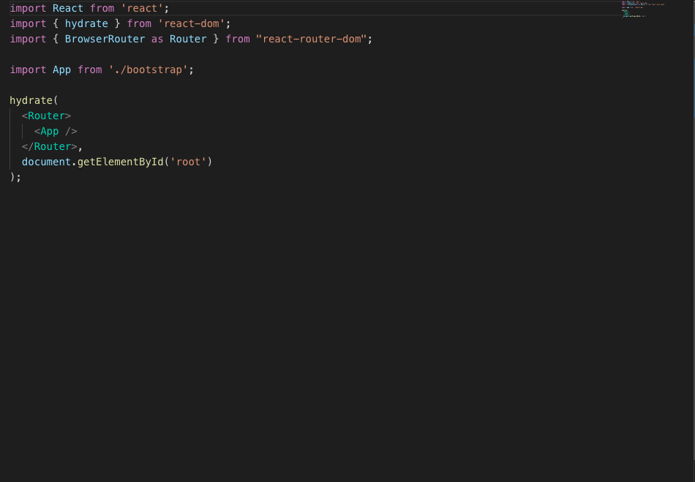
Setup router (client)
~/web/index.js

Slide 30
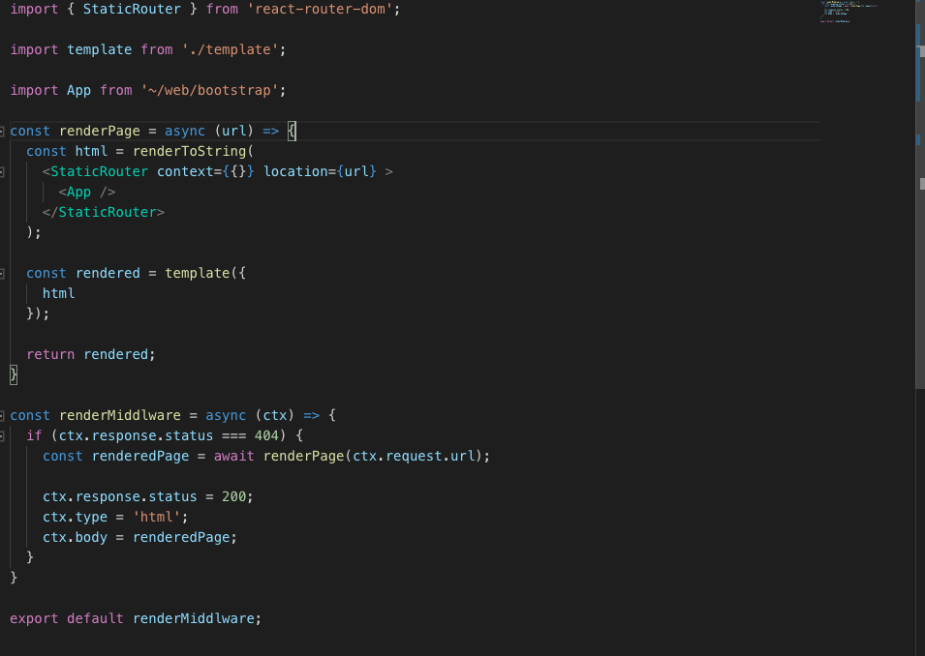
Setup router (server)
~/server/render.js

Slide 31
Redux

Slide 32
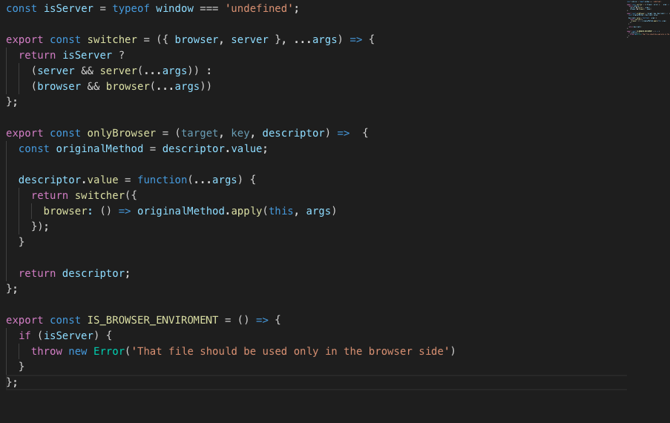
Same scripts on both sides
~/utils/index.js

Slide 33
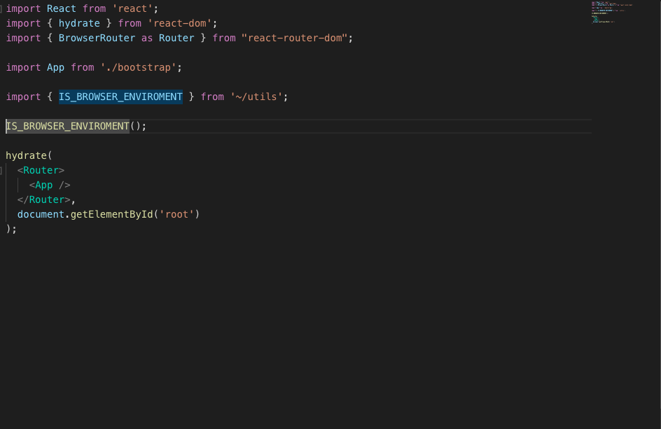
IS_BROWSER_ENVIRONMENT
~/web/index.js

Slide 34
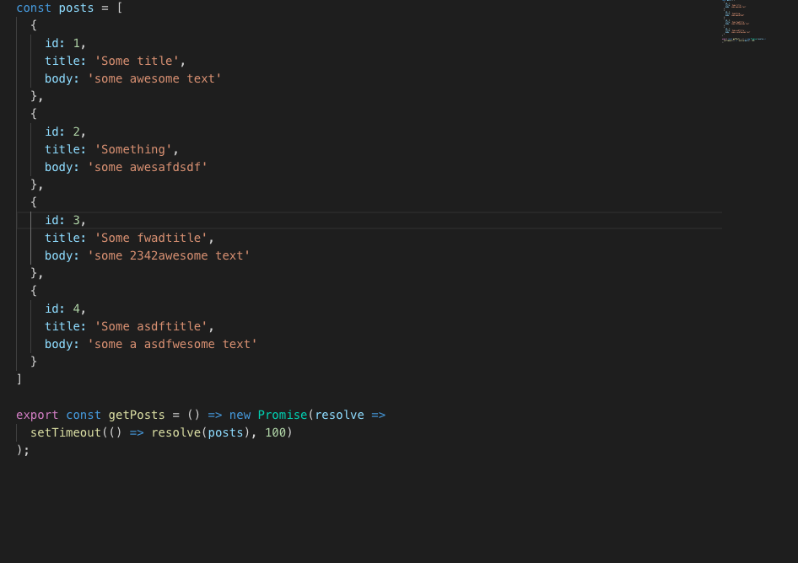
Create fake controller
~/server/controllers/post.js

Slide 35
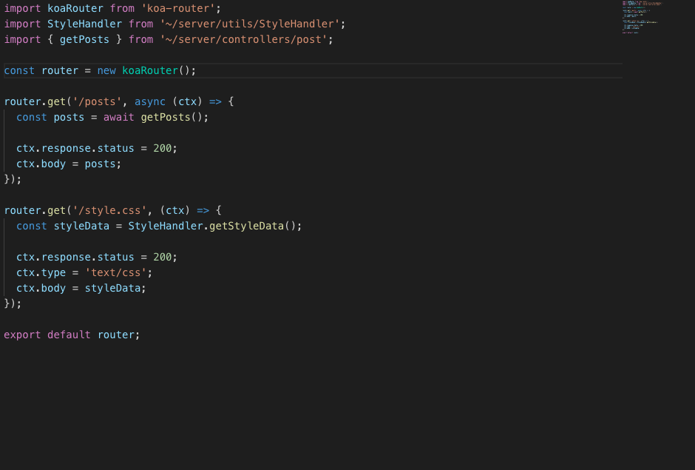
Create posts route
~/server/router/index.js

Slide 36
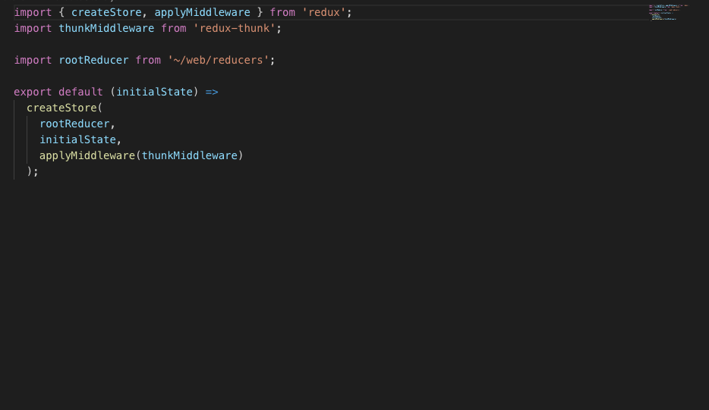
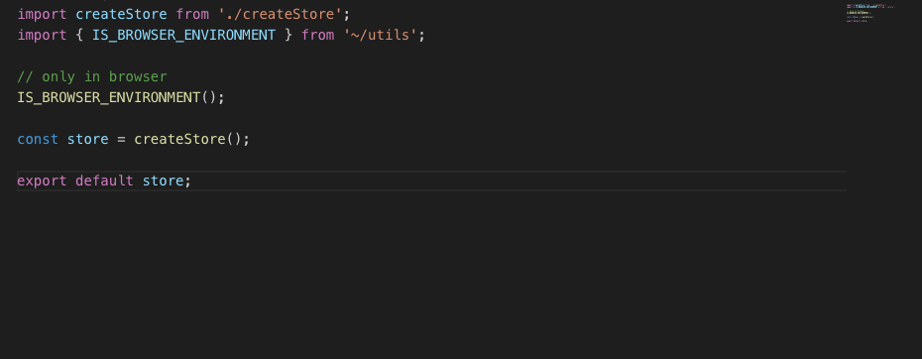
Creating store
~/web/store/createStore.js
~/web/store/store.js

Slide 37
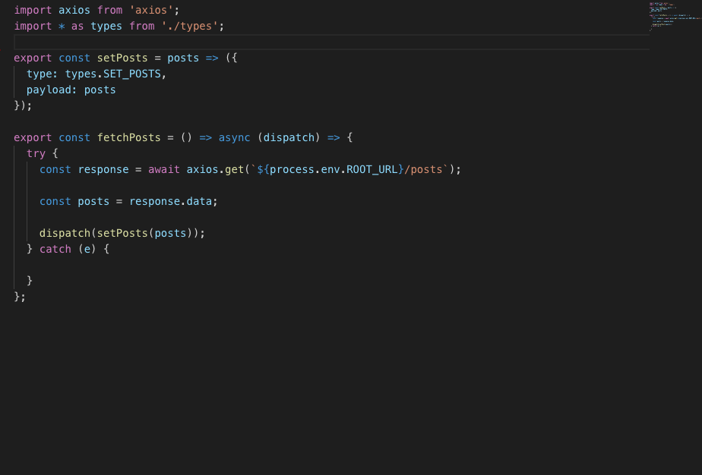
Add some reducers, actions and action creators
~/web/actions/home/index.js

Slide 38
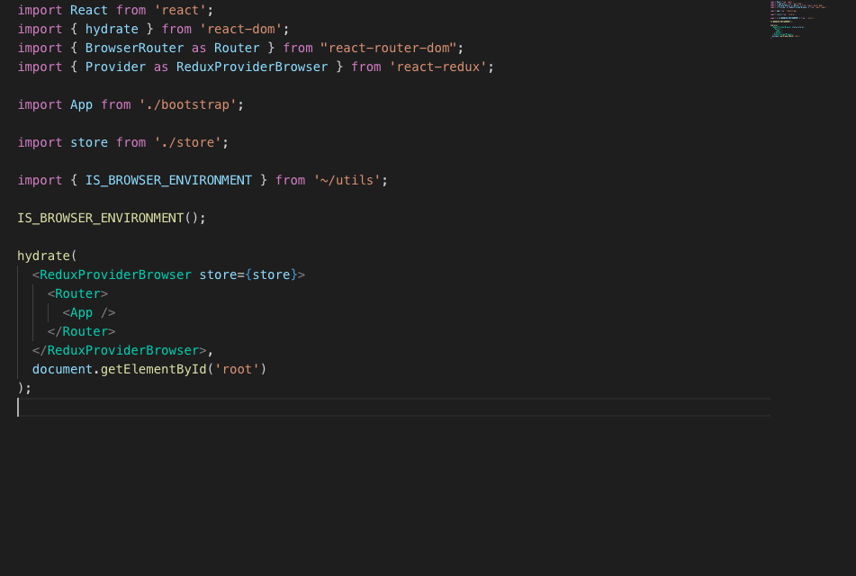
Setup Redux (client)
~/web/index.js

Slide 39
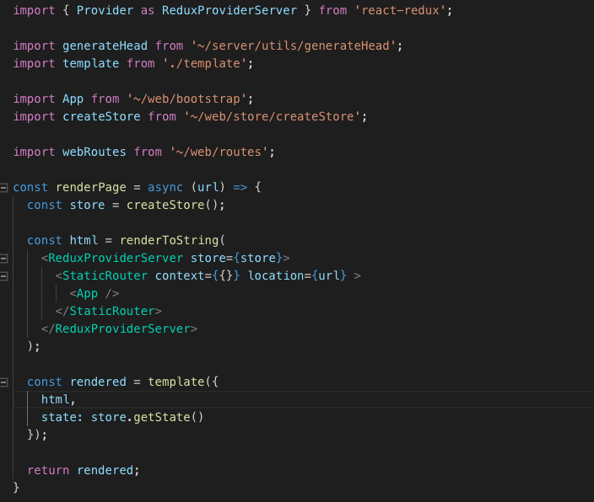
Setup Redux (server)
~/server/render/render.js

Slide 40
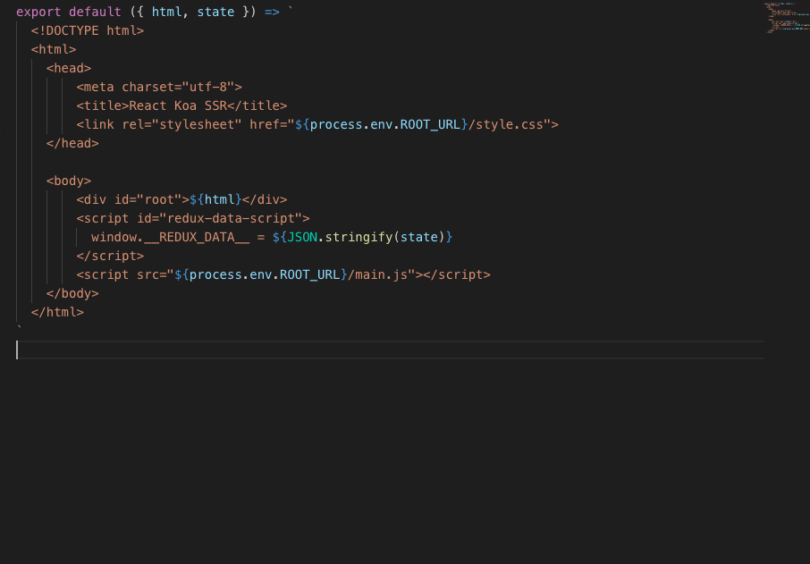
Update HTML template
~/server/render/template.js

Slide 41
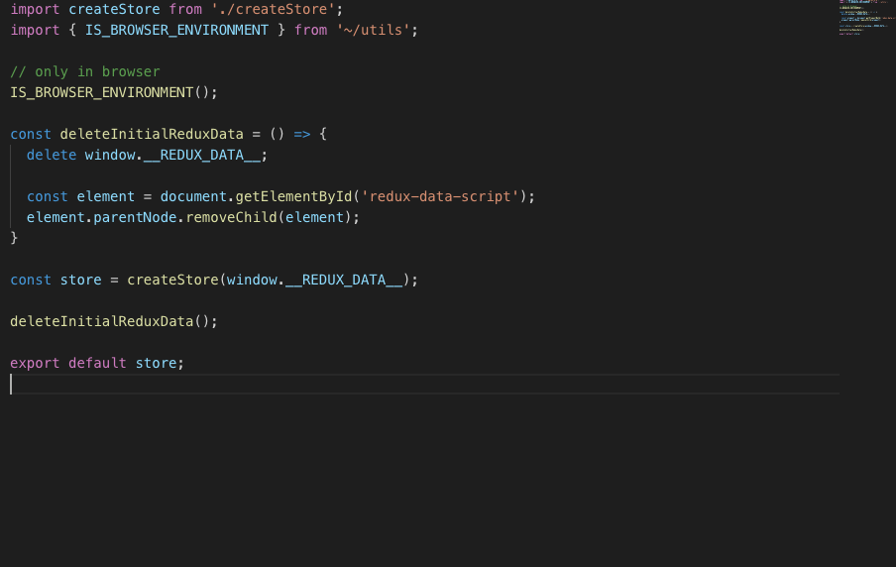
Set redux data from the server on the client
~/web/store/store.js

Slide 42
Getting/fetching data

Slide 43
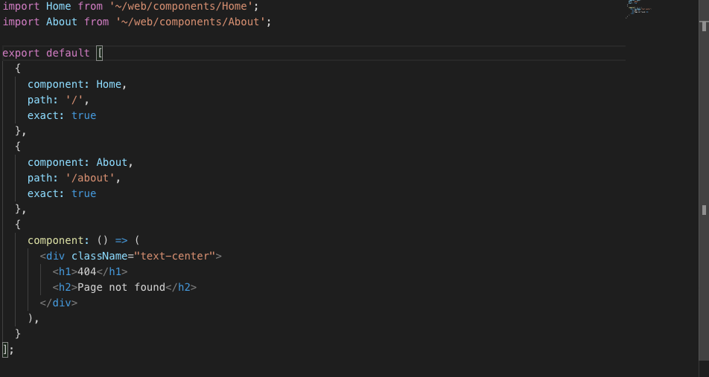
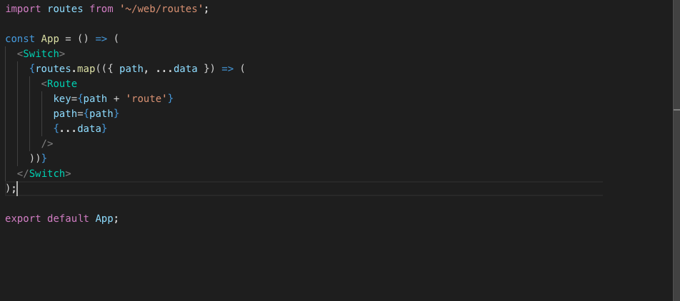
Make web routes array
~/web/routes/routes.js
~/web/bootstrap/index.js

Slide 44
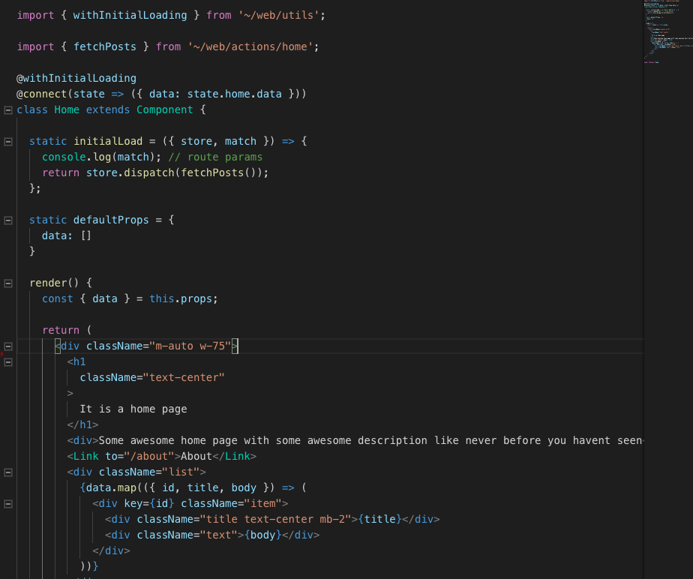
Add “initialLoad” static method and “withInitialLoading” decorator to the route component
~/web/components/Home/Home.js

Slide 45
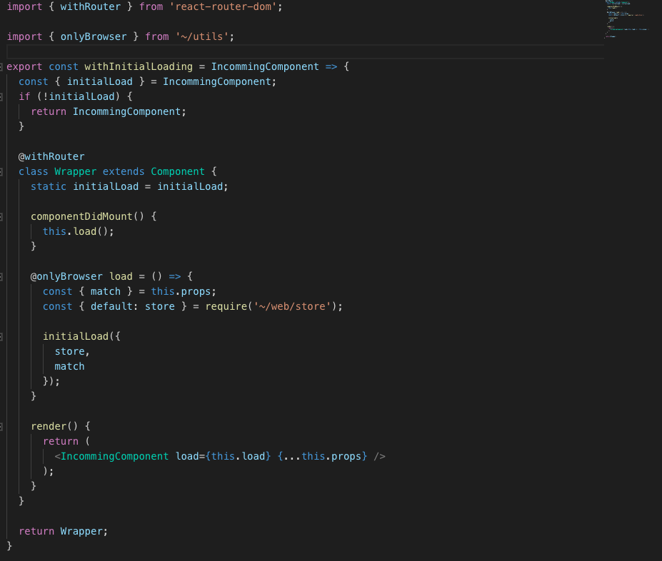
withInitialLoading
~/web/utils/withInitialLoading.js

Slide 46
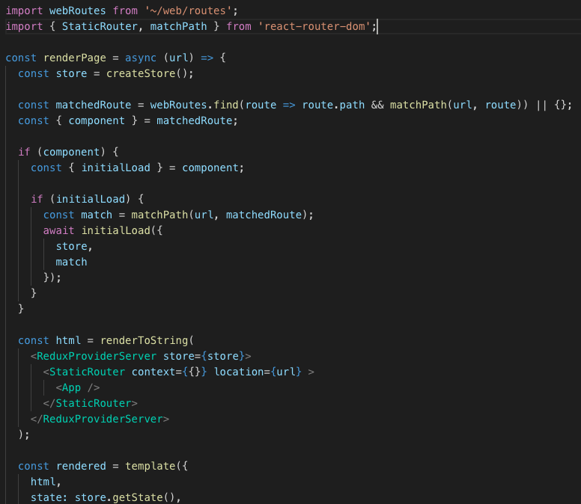
Calling initialLoad from the server
~/server/render/render.js

Slide 47
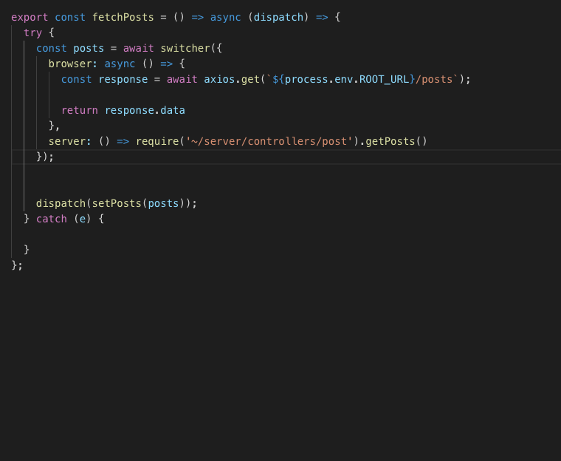
Update fetch posts method for getting date in better way
~/web/action/home/index.js

Slide 48
SEO

Slide 49
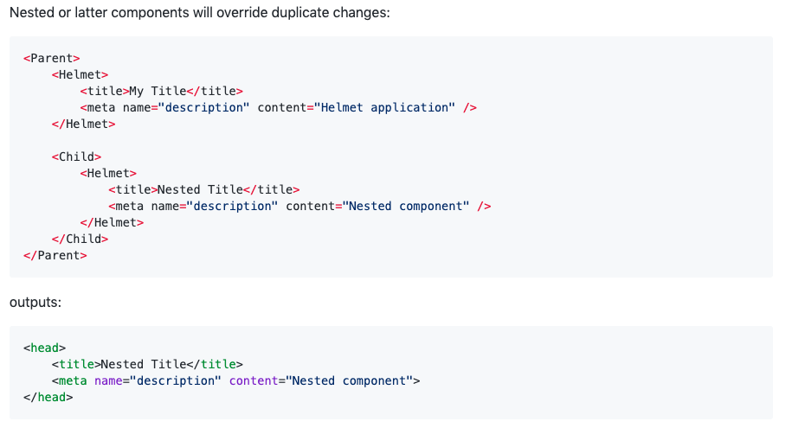
react-helmet

Slide 50
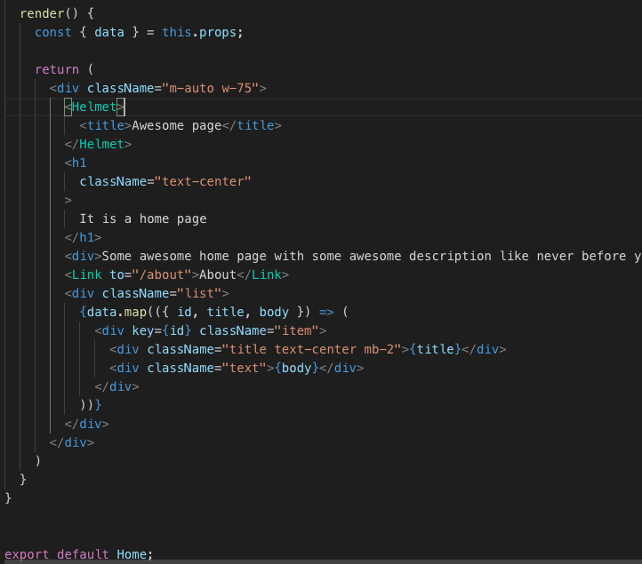
Add helmet to components
~/web/components/Home/Home.js

Slide 51
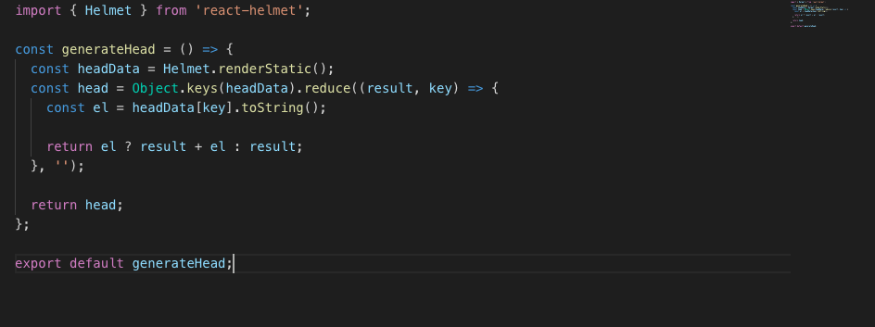
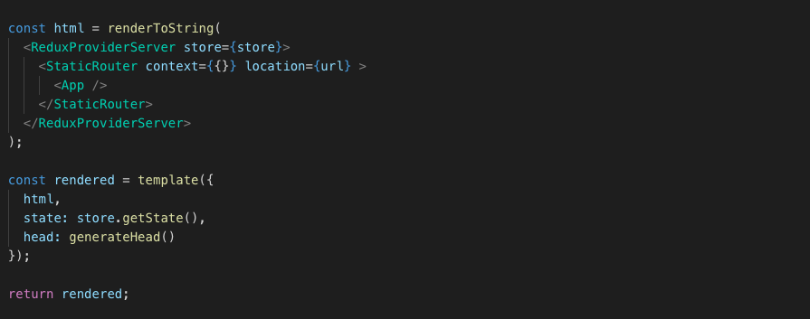
Helmet (server)
~/server/utils/generateHead.js
~/server/render/render.js

Slide 52
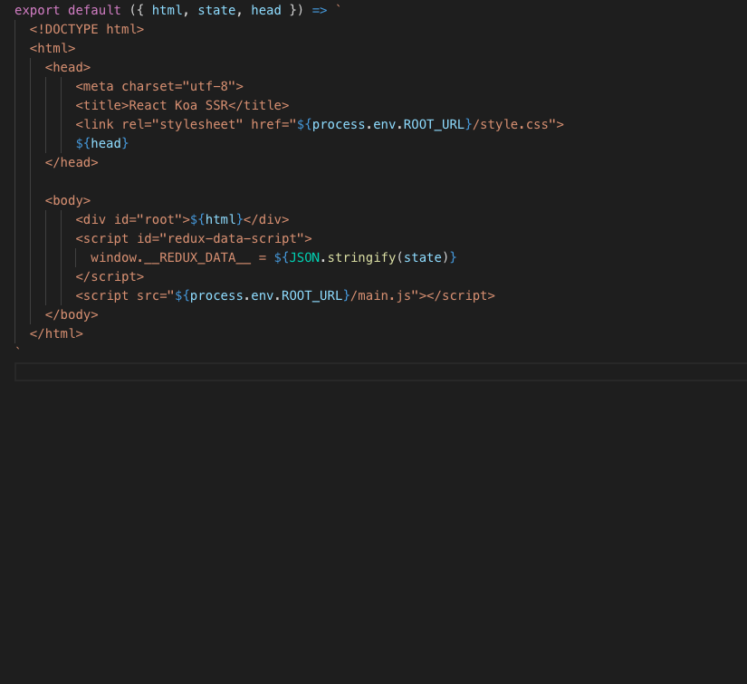
Update HTML template
~/server/render/template.js

Slide 53

What is the next step?
Hm...

Slide 54


Thanks!
https://github.com/yurkagon/React-Redux_Koa_SSR_boilerplate

